Slide 1
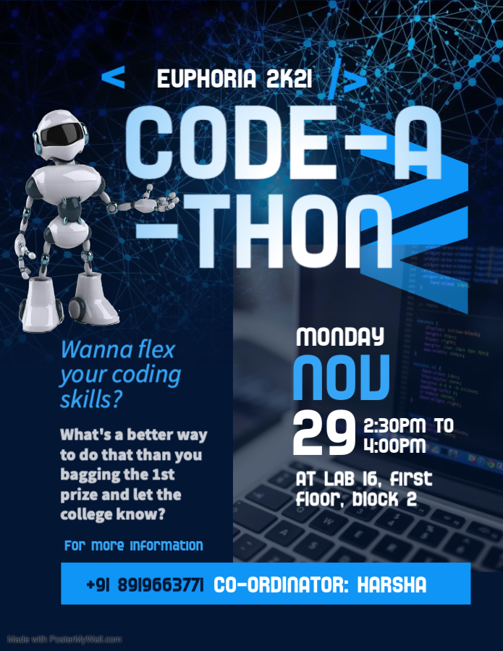
ROUND 3 : CODE CONVERT!

Slide 2
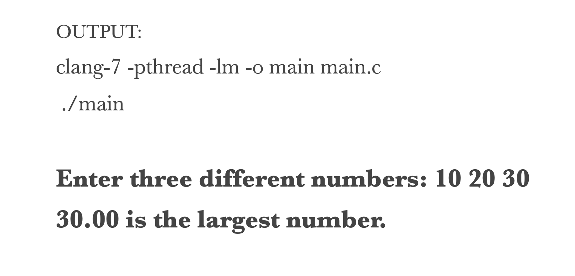
Q1. Convert the following C program code into C++ or Java or Python
PROGRAM NAME: CHECK THE BIGGEST OUT OF 3 NUMBERS
#include <stdio.h>
int main() {
double n1, n2, n3;
printf("Enter three different numbers: ");
scanf("%lf %lf %lf", &n1, &n2, &n3);
if( n1>=n2 && n1>=n3 ) printf("%.2f is the largest number.", n1);
if( n2>=n1 && n2>=n3 ) printf("%.2f is the largest number.", n2);
if( n3>=n1 && n3>=n2 ) printf("%.2f is the largest number.", n3);
return 0;
}

Slide 3
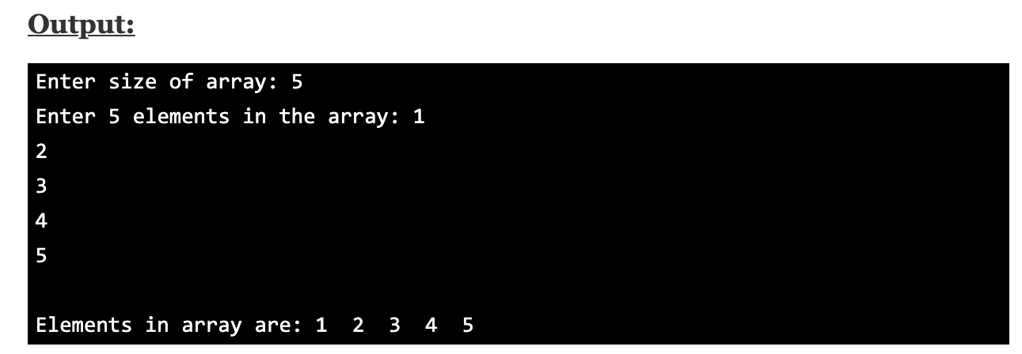
Q2. Convert the following C program code into C++ or Java or Python
PROGRAM NAME: PRINTING ARRAY ELEMENTS
#include<stdio.h>
int main()
{
int a[10],i,n;
printf("Enter size of array: ");
scanf("%d",&n);
printf("Enter %d elements in the array : ", n);
for(i=0;i<n;i++)
{
scanf("%d", &a[i]);
}
printf("\nElements in array are: ");
for(i=0;i<n;i++)
{
printf("%d ", a[i]);
}
return 0;
}

Slide 4
Q3. Convert the following C program code into C++ or Java or Python
PROGRAM NAME: STAR SQUARE PATTERN
#include <stdio.h>
int main()
{
int n;
printf("Enter the number of rows");
scanf("%d",&n);
for(int i=0;i<n;i++)
{
for(int j=0;j<n;j++)
{
printf("*");
}
printf("\n");
}
return 0;
}

Slide 5
Q4. Convert the following C program code into C++ or Java or Python
PROGRAM NAME: CHECK IF A STRING IS PALINDROME
#include <stdio.h>
#include <string.h>
int main() { char a[100], b[100];
printf("Enter a string to check if it's a palindrome\n"); gets(a);
strcpy(b, a); strrev(b);
if (strcmp(a, b) == 0) printf("The string is a palindrome.\n"); else printf("The string isn't a palindrome.\n");
return 0; }

Slide 6
Q5. Convert the following C program code into C++ or Java or Python
PROGRAM NAME: PRINT THE FIRST “N” NUMBERS IN FIBONACCI SERIES
#include <stdio.h>
int main() { int n, first = 0, second = 1, next, c;
printf("Enter the number of terms\n"); scanf("%d", &n);
printf("First %d terms of Fibonacci series are:\n", n);
for (c = 0; c < n; c++) { if (c <= 1) next = c; else { next = first + second; first = second; second = next; } printf("%d\n", next); }
return 0; }

